Slide 1
Computer and Robot Vision I
Chapter 7
Conditioning and Labeling
Presented by: 傅楸善 & 鄭忠宜
E-mail: r12922136@ntu.edu.tw
手機: 0933701058
授課教授：傅楸善 博士

Slide 2
Outline
7-1 Introduction
7-2 Noise cleaning with HW8
7-3 Sharpening
7-4 Edge detection with HW9, HW10
7-5 Line detection

Slide 3
7.1 Introduction
This chapter is organized by application. We discuss neighborhood operators:
For the conditioning operators of noise cleaning and sharpening.
For the labeling operators of edge and line detection.
Conditioning and labeling are among the most common uses of neighborhood operators.

Slide 4
1.2.1 Conditioning
Conditioning is based on a model that suggests that the observed image is composed of an informative pattern modified by uninteresting variations that typically add to or multiply the informative pattern.
e.g. noise suppression,
background normalization
DC & CV Lab.
CSIE NTU
Notes:
‹#›

Slide 5
1.2.2 Labeling
Labeling is based on a model that suggests that the informative pattern has structure as a spatial arrangement of events, each spatial event being a set of connected pixels.
e.g. thresholding, edge detection,
corner finding
DC & CV Lab.
CSIE NTU

Slide 6
7.1 Introduction
Conditioning:
Noise Cleaning (Sec. 7-2)
Background Normalization
Sharpening (Sec. 7-3)
Labeling:
Threshold operation
Edge Detection (Sec. 7-4)
Line Detection (Sec. 7-5)
Corner Detection

Slide 7
7-2 Noise Cleaning - Table of Contents
7-2-0 Noise Cleaning, Box Filter, and Gaussian Filter
7-2-1 Statistical Framework for Noise Removal
7-2-2 Determining Optimal Weight from Isotropic Covariance Matrices
7-2-3 Outlier or Peak Noise
7-2-4 K-nearest Neighbor
7-2-5 Gradient Inverse Weighted
7-2-6 Order Statistic Neighborhood Operators
7-2-7 Decision Theoretic Approach to Estimating Mean*
7-2-8 Hysteresis Smoothing
7-2-9 Sigma Filter
7-2-10 Selected Neighborhood Averaging
7-2-11 Minimum Mean Square Error Noise Smoothing
7-2-12 Noise Removal Experiments

Slide 8
7.2 Noise Cleaning
noise cleaning:
uses neighborhood spatial coherence
uses neighborhood pixel value homogeneity
a single white pixel surrounded by black pixels:
likely to be a noise
Denoise

Slide 9
7.2 Noise Cleaning
New Image
 |  | n(x,y)
Image
X axis
 | f(x-1,y-1) | f(x,y-1) | f(x+1,y-1)
 | f(x-1,y) | f(x,y) | f(x+1,y)
 | f(x-1,y+1) | f(x,y+1) | f(x+1,y+1)
3x3 Filter
W(-1,-1) | W(0,-1) | W(1,-1)
W(-1,0) | W(0,0) | W(1,0)
W(-1,1) | W(0,1) | W(1,1)
Y axis

Slide 10
7.2 Noise Cleaning
Padding: replicated border
1 | 1 | 2 | 3 | 3
1 | 1 | 2 | 3 | 3
4 | 4 | 5 | 6 | 6
7 | 7 | 8 | 9 | 9
7 | 7 | 8 | 9 | 9
1 | 2 | 3
4 | 5 | 6
7 | 8 | 9
Image
Image with Padding

Slide 11
7.2 Noise Cleaning
1 | 1 | 2 | 3 | 3
1 | 1 | 2 | 3 | 3
4 | 4 | 5 | 6 | 6
7 | 7 | 8 | 9 | 9
7 | 7 | 8 | 9 | 9
1 | 0 | 1
0 | 2 | 0
1 | 0 | 1
1x1 | 1x0 | 2x1
1x0 | 1x2 | 2x0
4x1 | 4x0 | 5x1
x
Filter
1 | 0 | 2
0 | 2 | 0
4 | 0 | 5
Image
+
14

Slide 12
7.2 Noise Cleaning
1 | 1 | 2 | 3 | 3
1 | 1 | 2 | 3 | 3
4 | 4 | 5 | 6 | 6
7 | 7 | 8 | 9 | 9
7 | 7 | 8 | 9 | 9
1 | 0 | 1
0 | 2 | 0
1 | 0 | 1
14
x
Filter
Image

Slide 13
7.2 Noise Cleaning
1 | 1 | 2 | 3 | 3
1 | 1 | 2 | 3 | 3
4 | 4 | 5 | 6 | 6
7 | 7 | 8 | 9 | 9
7 | 7 | 8 | 9 | 9
1 | 0 | 1
0 | 2 | 0
1 | 0 | 1
14 | 18
x
Filter
Image

Slide 14
7.2 Noise Cleaning
1 | 1 | 2 | 3 | 3
1 | 1 | 2 | 3 | 3
4 | 4 | 5 | 6 | 6
7 | 7 | 8 | 9 | 9
7 | 7 | 8 | 9 | 9
1 | 0 | 1
0 | 2 | 0
1 | 0 | 1
14 | 18
 |  | 34
x
Filter
Image

Slide 15
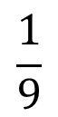


7.2 Noise Cleaning -box filter
box filter: computes equally weighted average
box filter: separable
Box filtering involves replacing each pixel of an image with the average in a box.
1 | 1 | 1
1 | 1 | 1
1 | 1 | 1
1
1
1
×
1 | 1 | 1
equally weighted average
separable

Slide 16
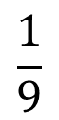
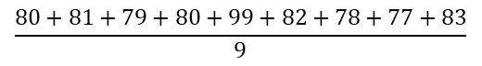

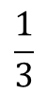
7.2 Noise Cleaning -box filter: separable
80 | 81 | 79
80 | 99 | 82
78 | 77 | 83
沒separable → 9倍計算時間
1 | 1 | 1
1 | 1 | 1
1 | 1 | 1
×
= 82
= 82
image
Separable → 6倍計算時間:
一個二維的濾波器係數矩陣可以
拆成兩個唯一的Column Vector 乘上 Row Vector
80 | 81 | 79
80 | 99 | 82
78 | 77 | 83
 | 80
 | 87
 | 79
1
1
1
×
1 | 1 | 1
×
= 82

Slide 17
7.2 Noise Cleaning -box filter: speedup
1 | 2 | 3 | 4 | 5
1 | 1 | 1
 | 6 | 9 | 12
×
=
1 | 2 | 3 | 4 | 5
: 1 + 2 + 3 = 6
1 | 2 | 3 | 4 | 5
: 6 – 1 + 4 = 9
1 | 2 | 3 | 4 | 5
: 9 – 2 + 5 = 12

Slide 18
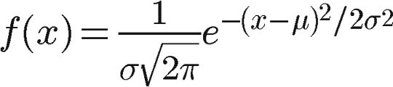
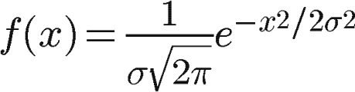
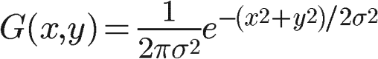
7.2 Noise Cleaning -Gaussian filter

Slide 19
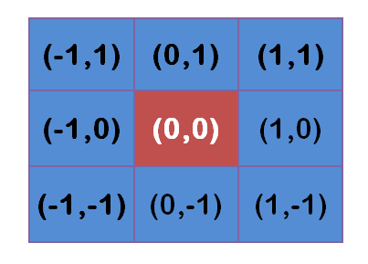
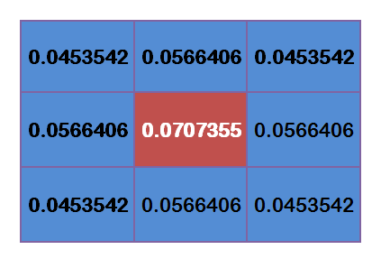
7.2 Noise Cleaning -Gaussian filter
Assuming σ=1.5, the weight matrix with blur radius of 1 is as follows:

Slide 20
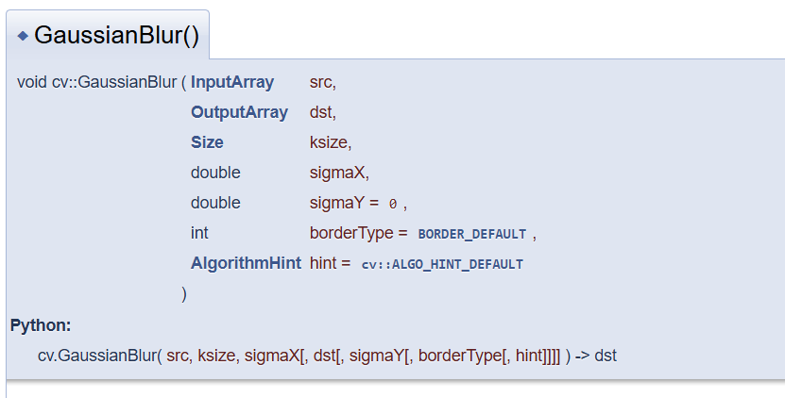
7.2 Noise Cleaning -Gaussian filter

Slide 21
7.2 Noise Cleaning -Gaussian filter
Kernel size: 2 or 3 σ from the center
The 68–95–99.7 rule.

Slide 22

7.2 Noise Cleaning
圖1
圖2

Slide 23
Summary
Linear shift-invariant operator (Ch. 6)
Separable filter
Box filter
Gaussian filter

Slide 24
7.2 Effect of Linear Filters
Defocusing
Edges blurred

Slide 25
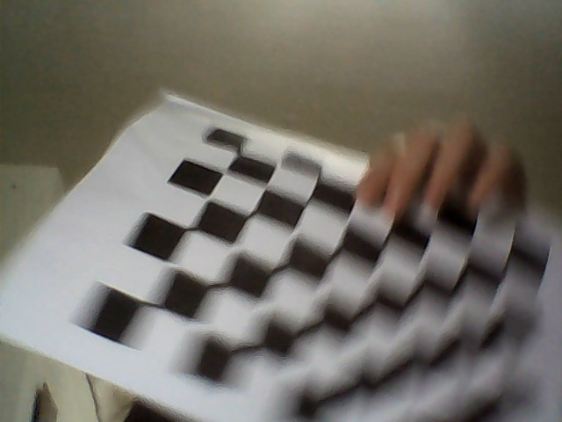
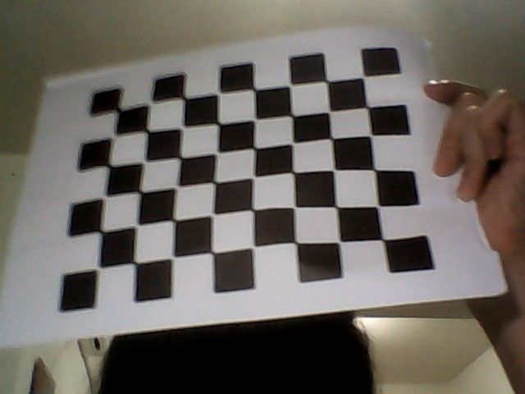
Defocusing images & edges blurred
Defocusing
Edges blurred

Slide 26
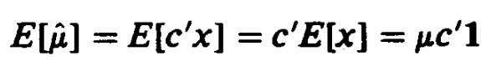
7.2.1 A Statistical Framework for Noise Removal
Idealization:
if no noise, each neighborhood the same constant (μ).
x: observed neighborhood pixels
c: coefficients of the filter

Slide 27
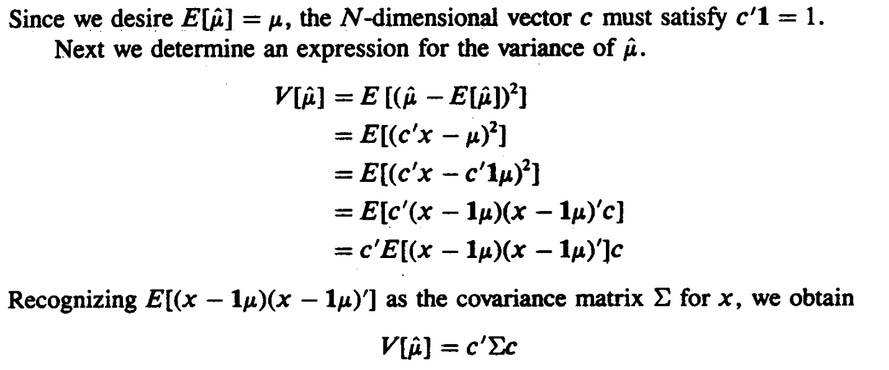
7.2.1 A Statistical Framework for Noise Removal

Slide 28
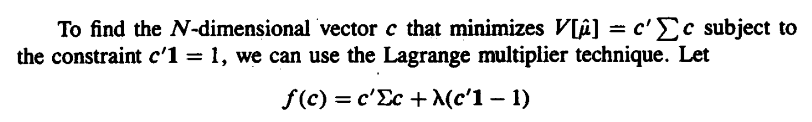
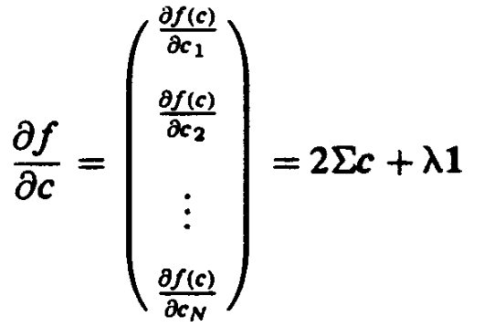
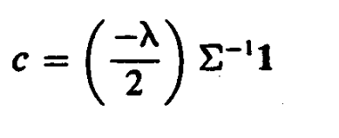
7.2.1 A Statistical Framework for Noise Removal

Slide 29
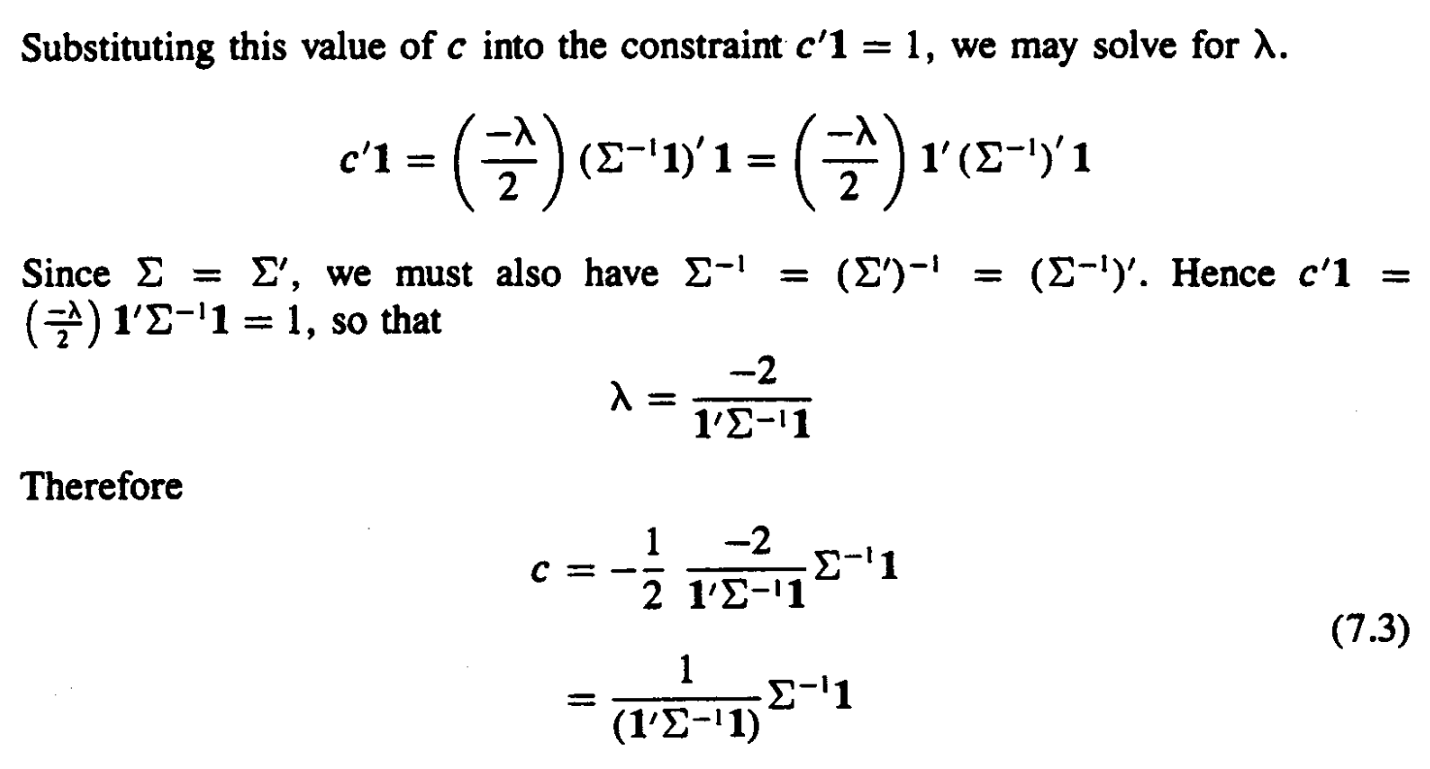
7.2.1 A Statistical Framework for Noise Removal

Slide 30
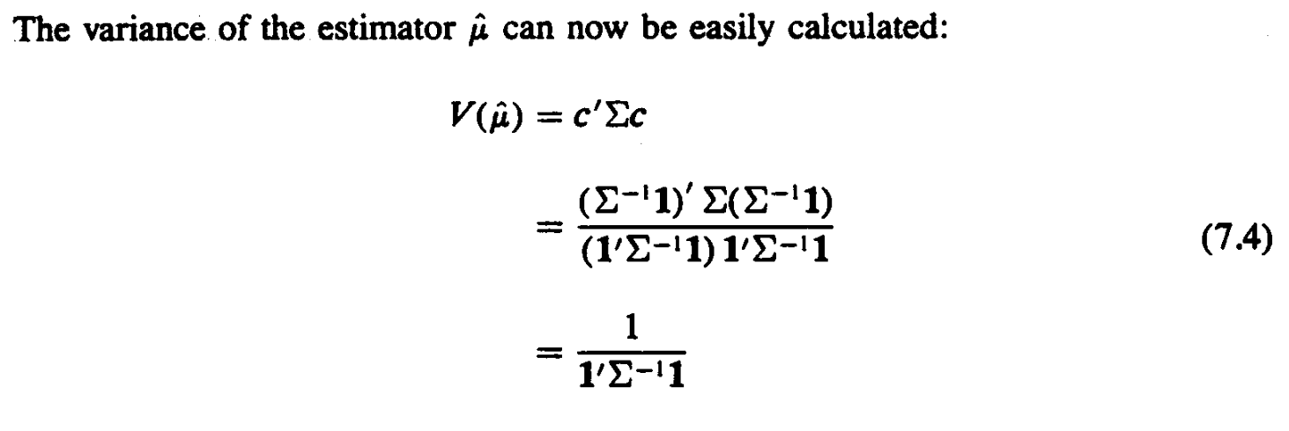
7.2.1 A Statistical Framework for Noise Removal

Slide 31
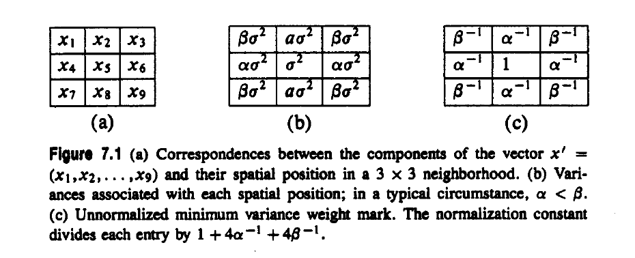
7.2.1 A Statistical Framework for Noise Removal
Assumption: random noise is uncorrelated

Slide 32
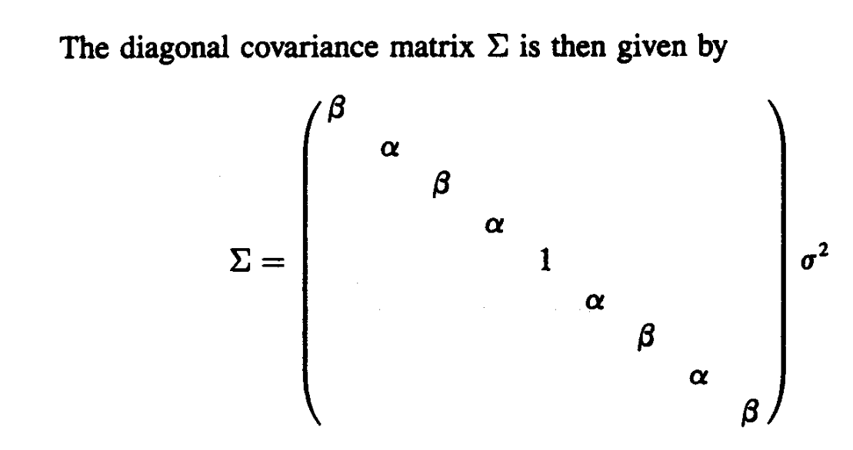
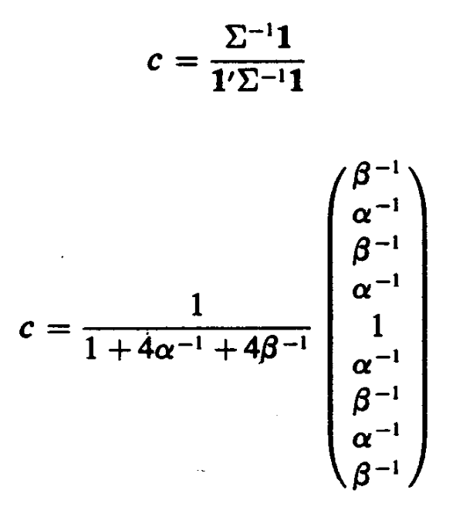
7.2.1 A Statistical Framework for Noise Removal

Slide 33
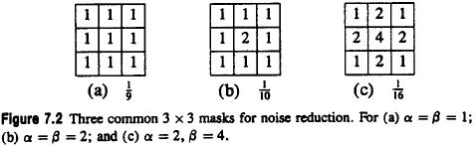
7.2.1 A Statistical Framework for Noise Removal
Assumption: random noise is uncorrelated

Slide 34
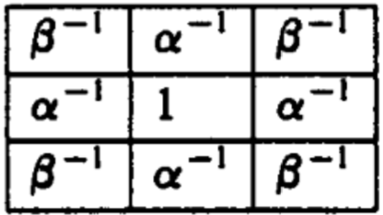
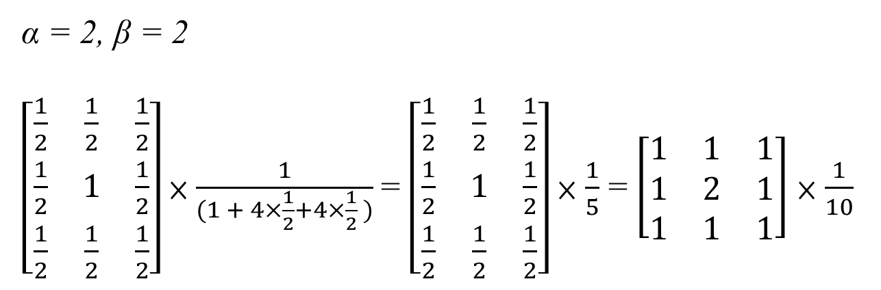
7.2.1 A Statistical Framework for Noise Removal
Assumption: random noise is uncorrelated

Slide 35
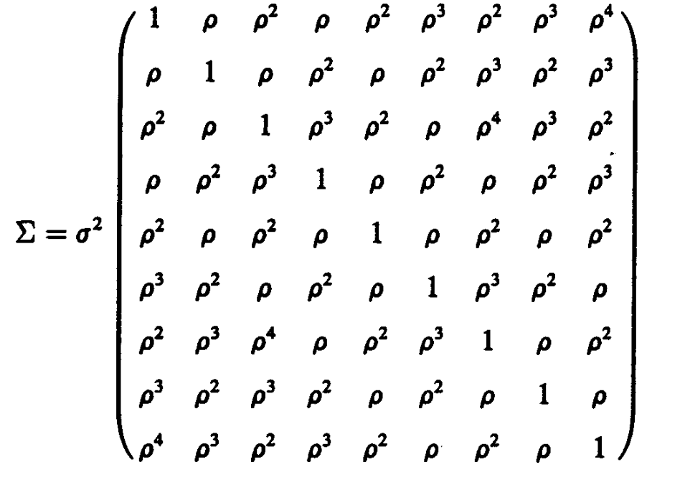
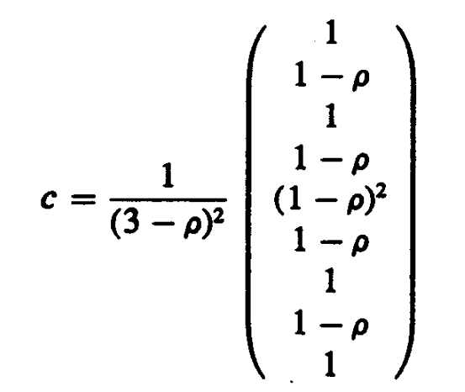
7.2.1 A Statistical Framework for Noise Removal
Assumption: correlation ρ^{n}, n > 1, at distance n apart
Assumption: all pixels have the same variance
0 | 1 | 2
1 | 2 | 3
2 | 3 | 4

Slide 36
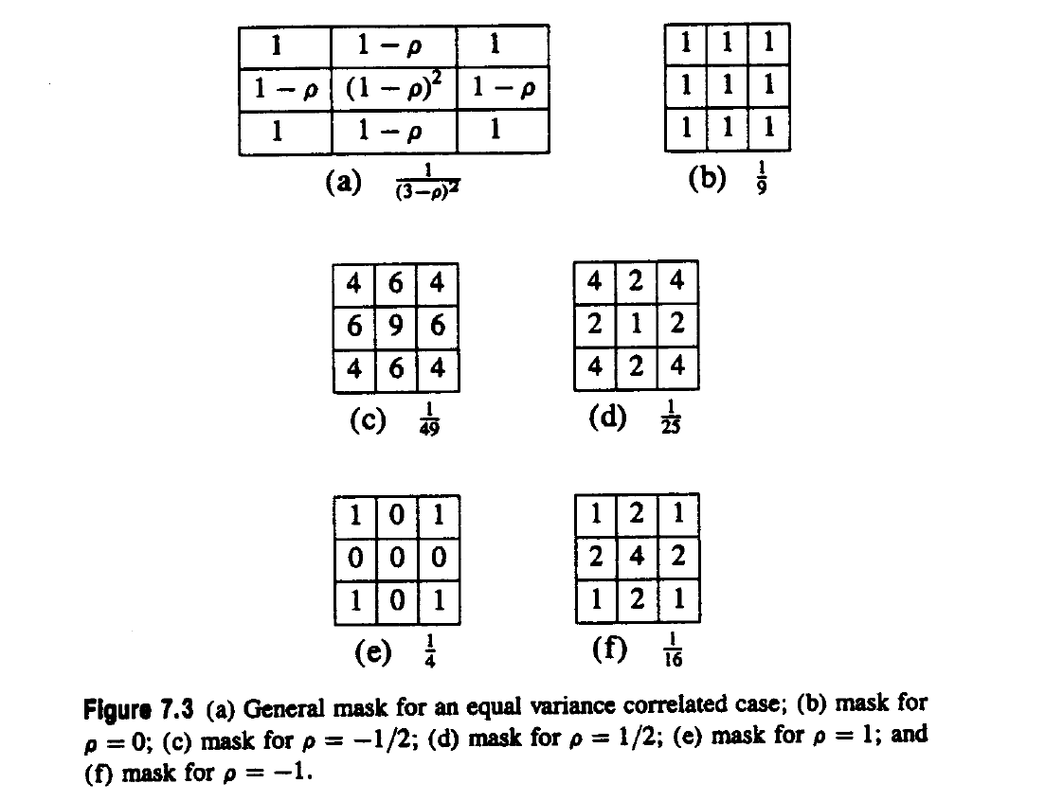
7.2.1 A Statistical Framework for Noise Removal
Assumption: correlation ρ^{n}, n > 1, at distance n apart
Assumption: all pixels have the same variance

Slide 37
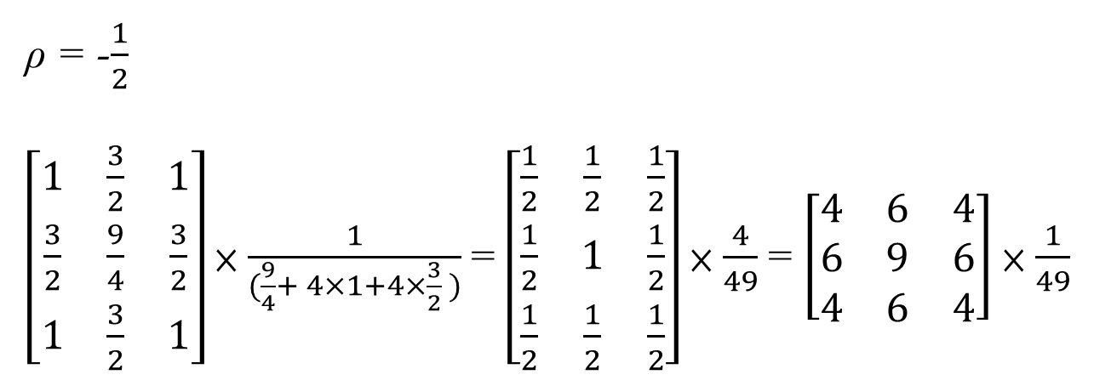
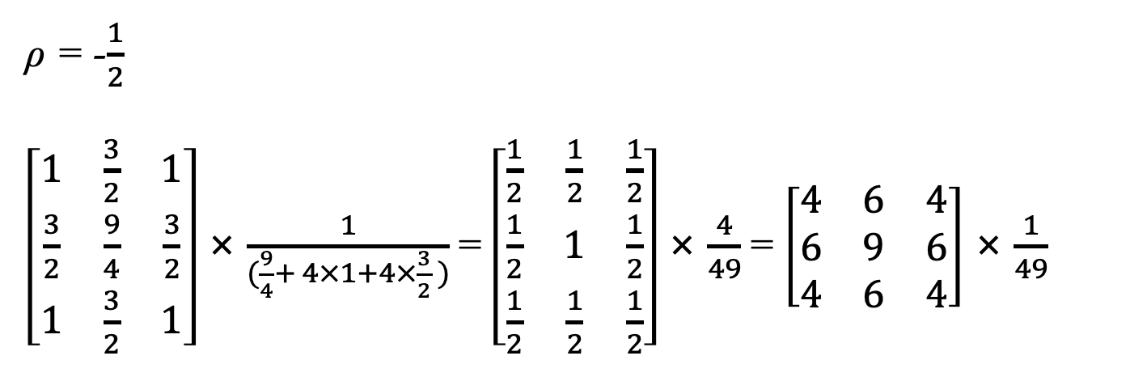
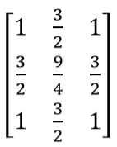
7.2.1 A Statistical Framework for Noise Removal
Assumption: correlation ρ^{n}, n > 1, at distance n apart
Assumption: all pixels have the same variance

Slide 38
7.2.3 Outlier or Peak Noise
outlier (peak noise):
pixel value replaced by random noise value
neighborhood size:
larger than noise, smaller than preserved detail
center-deleted:
neighborhood pixel values in neighborhood except center

Slide 39
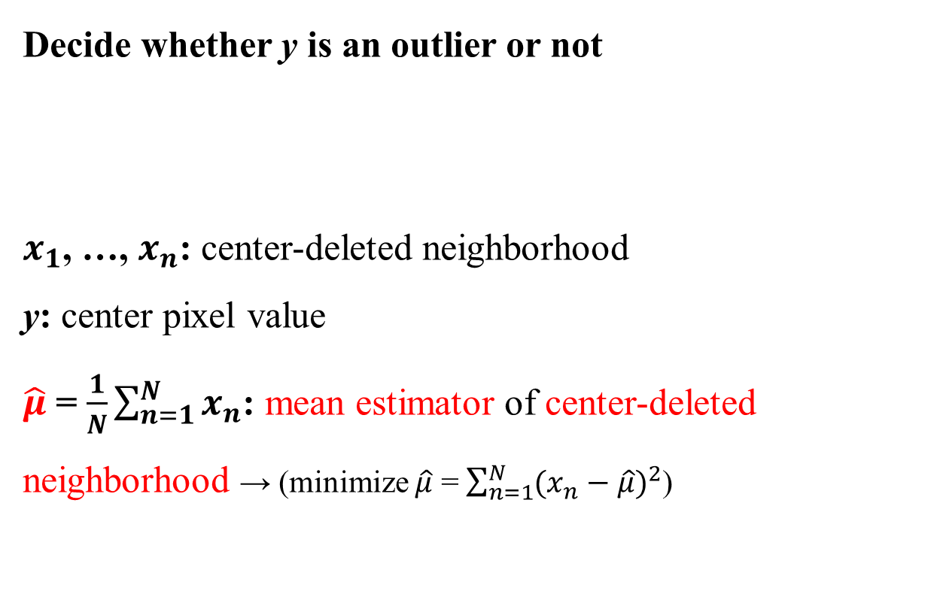
7.2.3 Outlier or Peak Noise
 | y

Slide 40
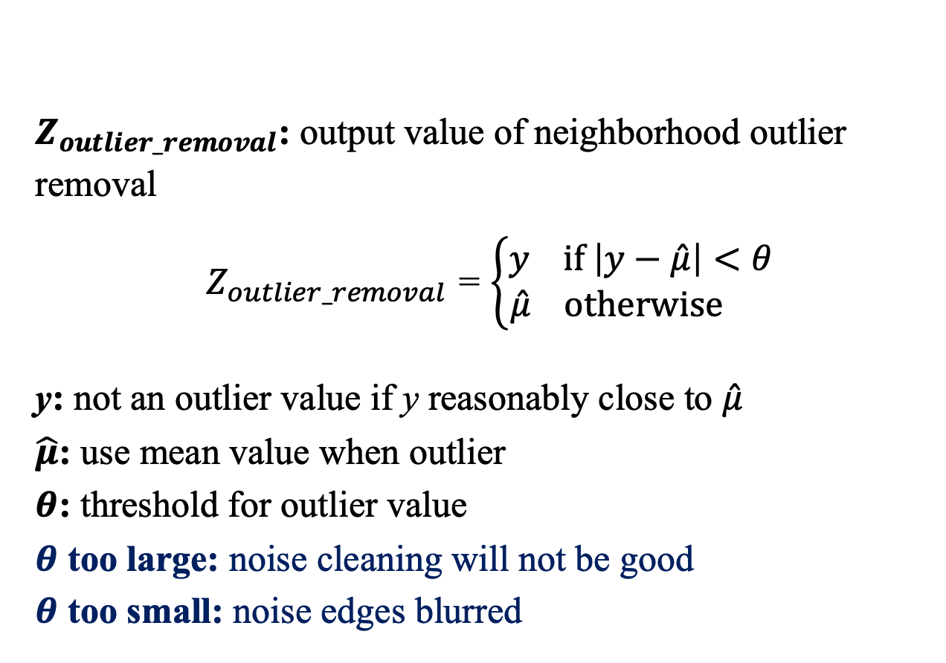
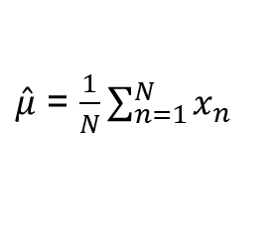
7.2.3 Outlier or Peak Noise

Slide 41
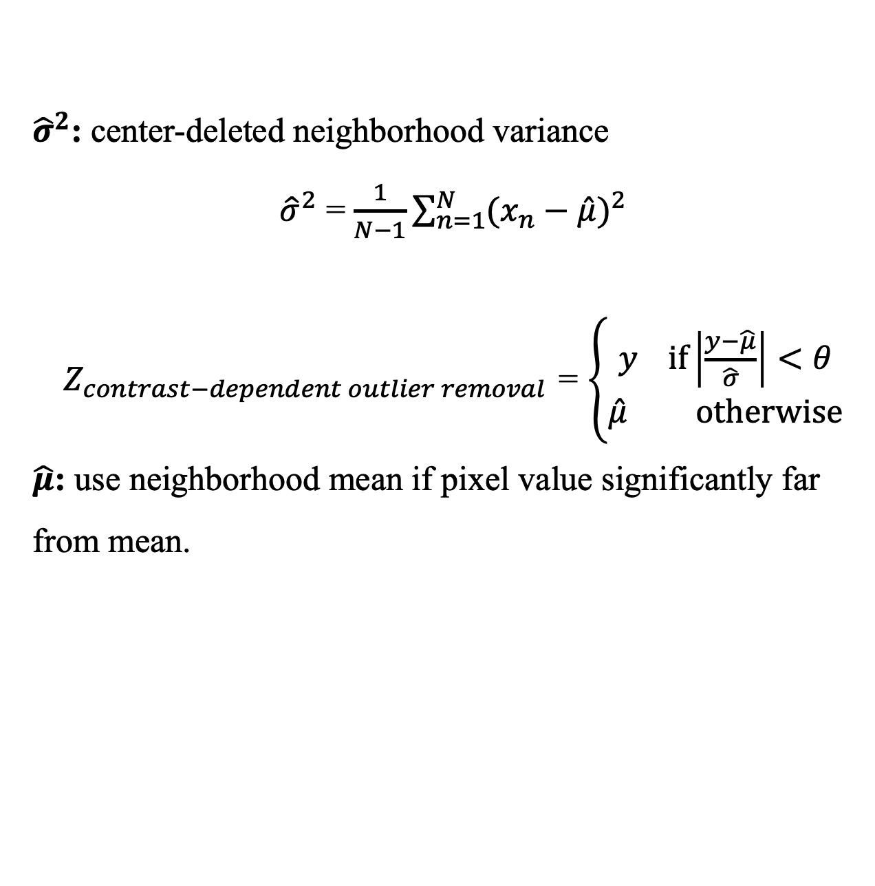
7.2.3 Outlier or Peak Noise

Slide 42
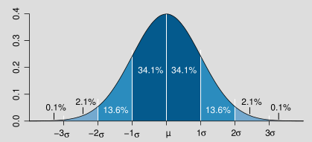
7-2-3 Outlier or Peak Noise
If theta (θ) = 1

Slide 43
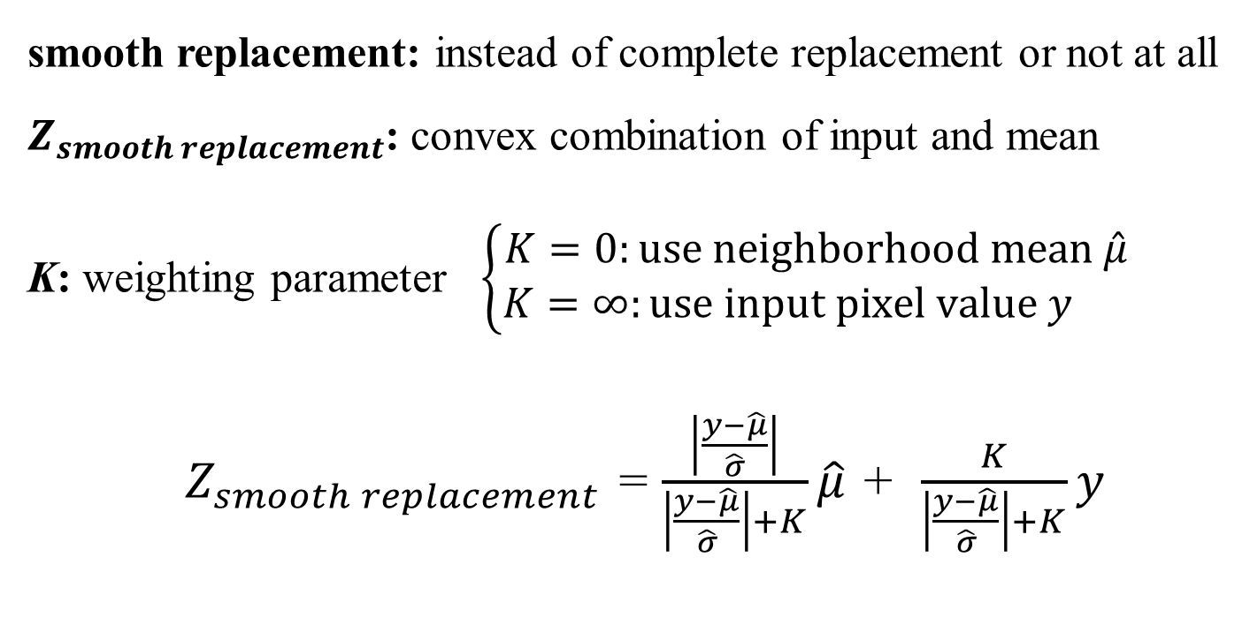
7.2.3 Outlier or Peak Noise

Slide 44
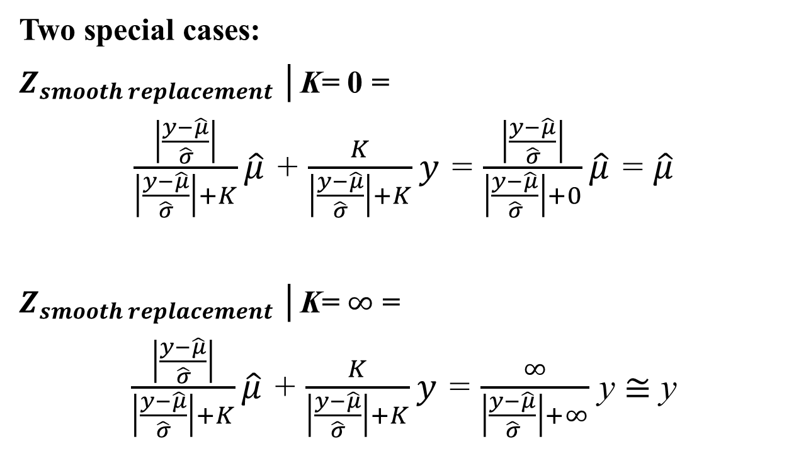
7.2.3 Outlier or Peak Noise

Slide 45
7.2.4 K-Nearest Neighbor
K-nearest neighbor:
Equally weighted average of the k-closest pixel values.

Slide 46
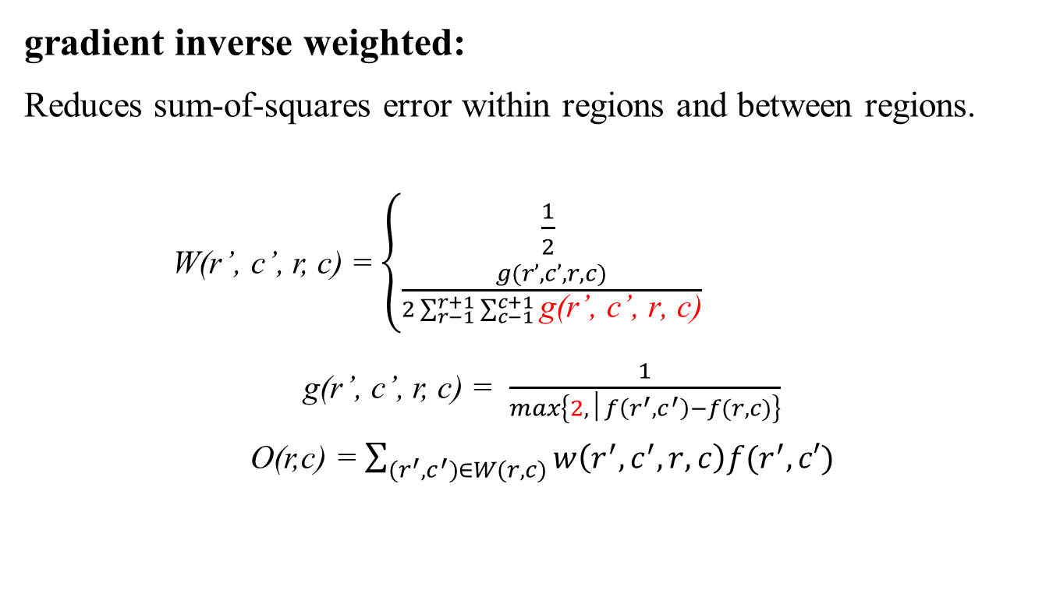
7.2.5 Gradient Inverse Weighted
(r’,c’) = (r,c)
otherwise

Slide 47
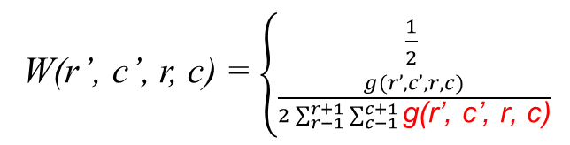
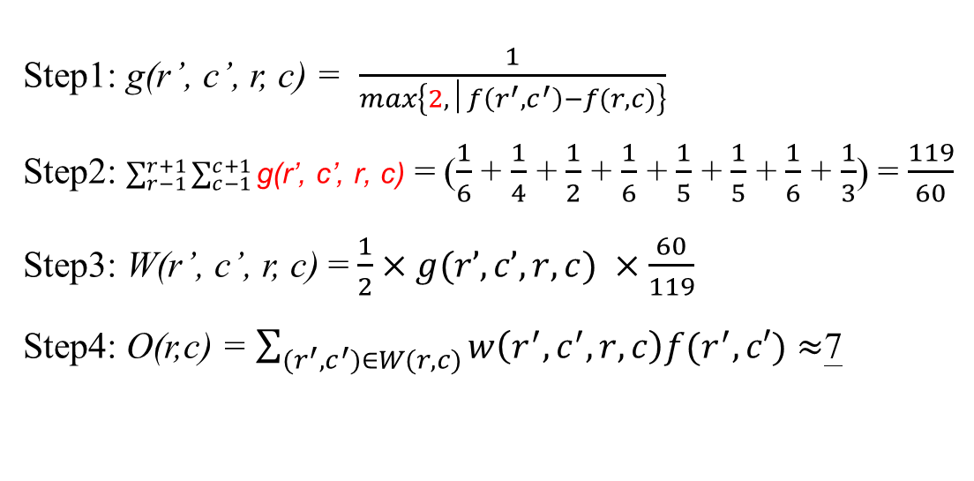
7.2.5 Gradient Inverse Weighted
f =
3 | 5 | 7
3 | 9 | 4
4 | 3 | 6
(r’,c’) = (r,c)
otherwise
g =
0.042 | 0.063 | 0.126
0.042 | 0.5 | 0.051
0.051 | 0.042 | 0.083
W=

Slide 48
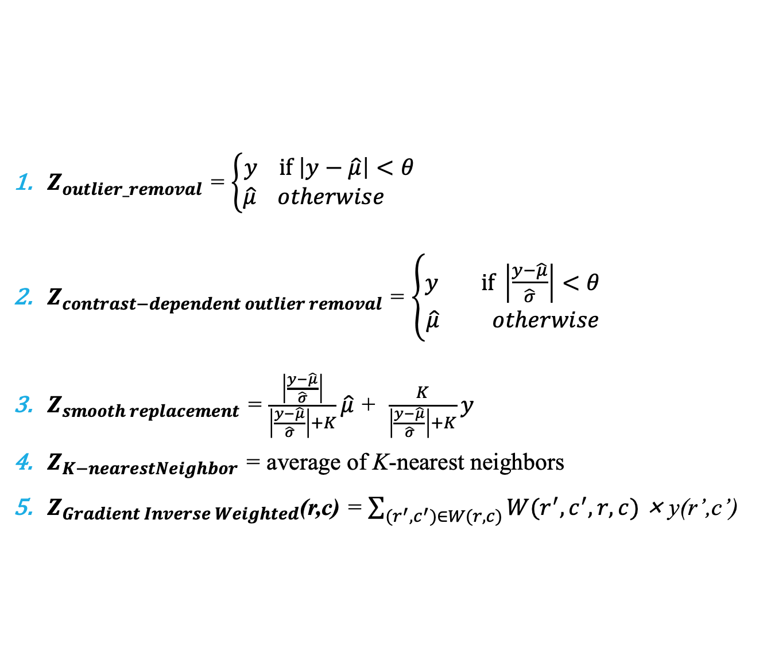
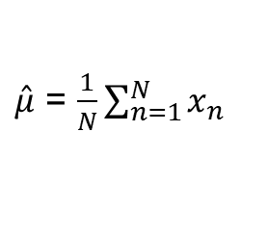
Noise Removal Method Recap (5 methods)

Slide 49
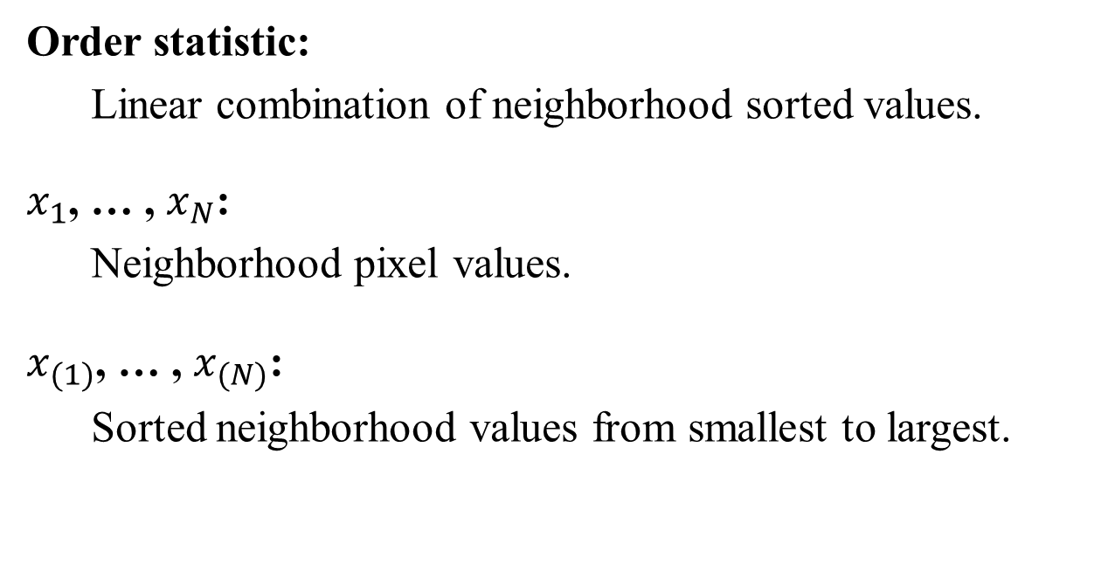
7.2.6 Order Statistic Neighborhood Operators

Slide 50
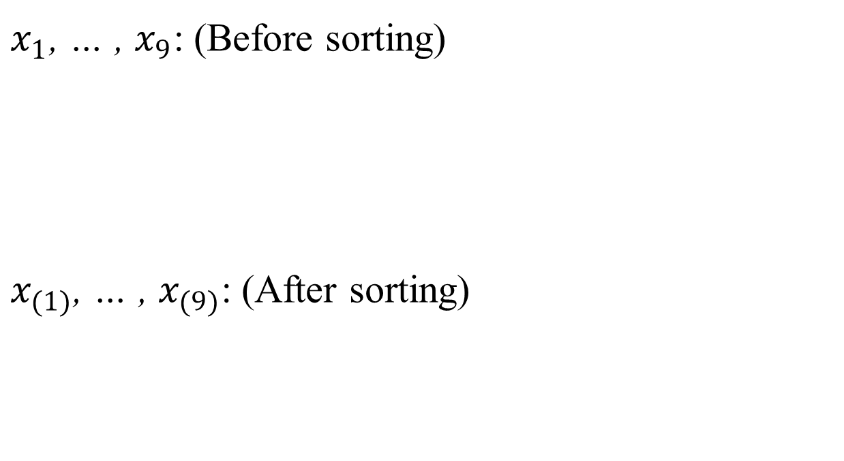
7.2.6 Order Statistic Neighborhood Operators
16 | 128 | 109 | 66 | 4 | 6 | 96 | 84 | 53
4 | 6 | 16 | 53 | 66 | 84 | 96 | 109 | 128

Slide 51
7.2.6 Order Statistic Neighborhood Operators-Median Operator
Median Operator
median: most common order statistic operator.
median root:
1. fixed-point result of a median filter.
2. median roots consist only constant-valued neighborhoods, sloped edges.

Slide 52


Median Root Image
Original Image

Slide 53
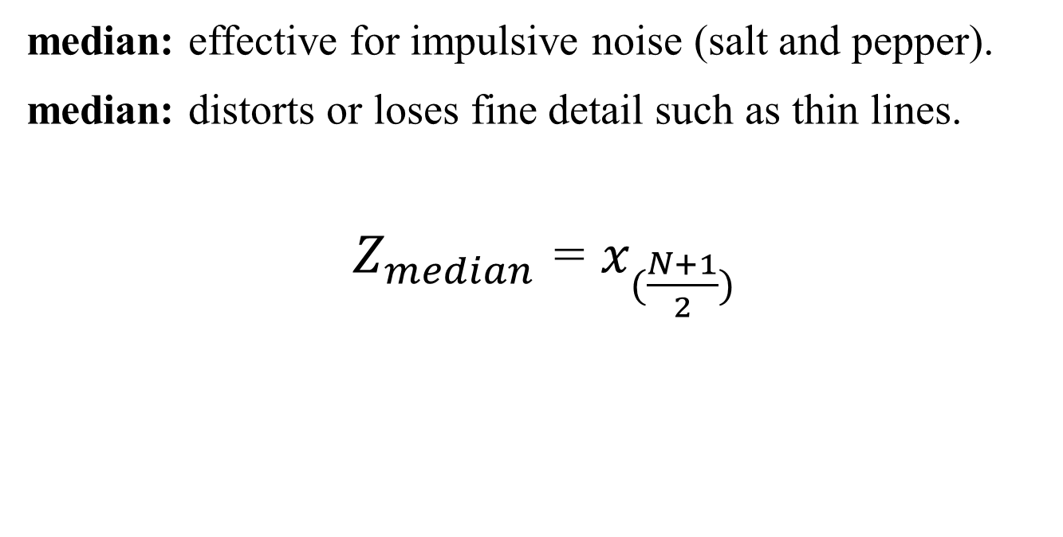
7.2.6 Order Statistic Neighborhood Operators -Median Operator

Slide 54
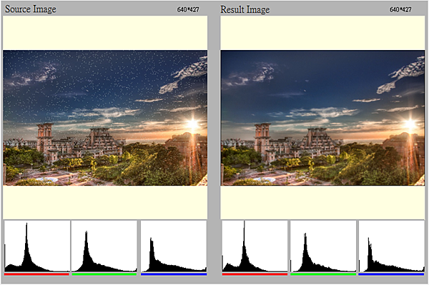

Slide 55
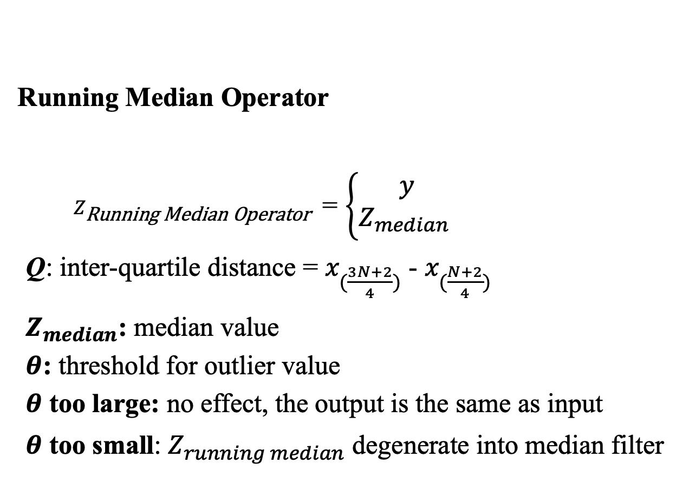
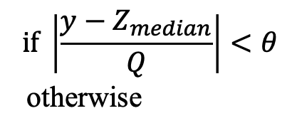
7.2.6 Order Statistic Neighborhood Operators - Running Median Filter

Slide 56
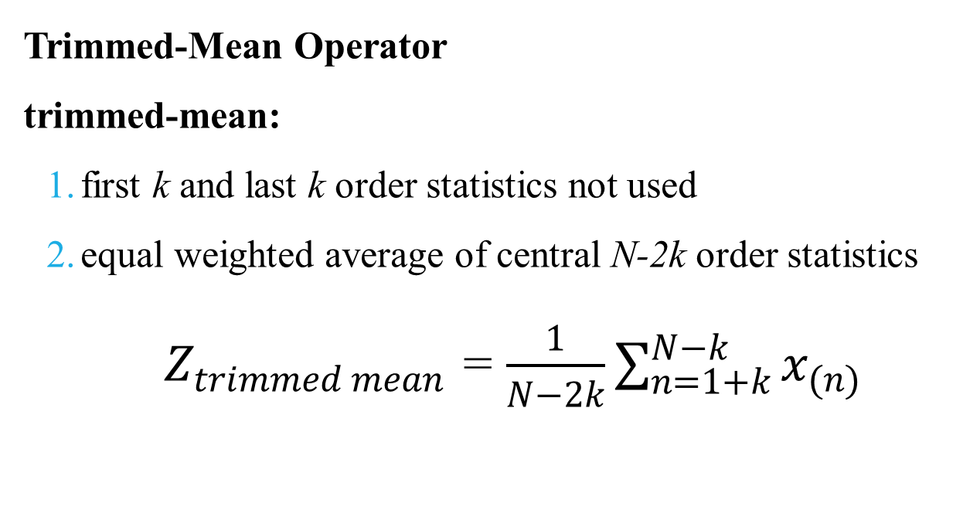
7.2.6 Order Statistic Neighborhood Operators

Slide 57

7.2.6 Order Statistic Neighborhood Operators

Slide 58
7.2.8 Hysteresis Smoothing
hysteresis smoothing:
removes minor fluctuations, preserves major transients
finite state machine with two states: UP, DOWN
applied row-by-row and then column-by-column
run the second pass in reversed order (left-to-right / right-to-left)
the output is the average of the two results

Slide 59




7.2.8 Hysteresis Smoothing
if state UP and next one smaller, if next local minimum does not exceed threshold then stays current value i.e. small valley filled flat
otherwise state changes from UP to DOWN and preserves major transients

Slide 60



7.2.8 Hysteresis Smoothing
if state DOWN and next one larger, if next local maximum does not exceed threshold then stays current value i.e. small peak cuts flat
otherwise state changes from DOWN to UP and preserves major transients

Slide 61



7.2.8 Hysteresis Smoothing

Slide 62

7.2.9 Sigma Filter

Slide 63
7.2.10 Selected-Neighborhood Averaging
selected-neighborhood averaging:
assumes pixel a part of homogeneous region. For example, there are nine 3×3 neighborhoods that contains a given pixel.
noise-filtered value:
mean value from lowest variance neighborhood.

Slide 64
Noise Removal Method Recap (10 methods)

Slide 65


Noise Removal Method Recap (10 methods)

Slide 66

Image Quality Benchmark

Slide 67

Noise-removal Techniques-experiments

Slide 68
7.2.12 Noise-Removal Techniques-Experiments
types of noise:
Uniform
Gaussian
Salt and pepper
Varying noise (the noise energy varies across the image)

Slide 69
Project due Nov. 26, 2024
HW8
Write the following programs
Generate additive white Gaussian noise (2 images)
Generate salt-and-pepper noise (2 images)
Run box filter (3×3, 5×5) on all noisy images (8 images)
Run median filter (3×3, 5×5) on all noisy images (8 images)
Run opening followed by closing and closing followed by opening.
(8 images)
You must calculate the signal-to-noise ratio (SNR) for each instance (4 noisy images and 24 processed images)

Slide 70
Project due Nov. 26, 2024
HW8
Generate additive white Gaussian noise:
I(nim, i, j) = I(im, i, j) + amplitude＊N(0, 1)
N(0, 1): Gaussian random variable with zero mean and st. dev. 1
amplitude determines signal-to-noise ratio, try 10 and 30
Generate salt-and-pepper noise:
I(nim, i, j) = 0 if uniform(0, 1)< threshold
I(nim, i, j) = 255 if uniform(0, 1)>1- threshold
I(nim, i, j) = I(im, i, j) otherwise
uniform(0, 1): random variable uniformly distributed over [0, 1]
threshold determines signal-to-noise ratio, try both 0.05 and 0.10

Slide 71

Generate additive white Gaussian noise
with amplitude = 10

Slide 72

Generate additive white Gaussian noise
with amplitude = 30

Slide 73

Generate salt-and-pepper noise
with threshold = 0.05

Slide 74

Generate salt-and-pepper noise
with threshold = 0.1

Slide 75

Box filter on white Gaussian noise with amplitude = 10
Gaussian noise
After 3x3 box filter

Slide 76

Box filter on salt-and-pepper noise with threshold = 0.05
salt-and-pepper noise
After 3x3 box filter

Slide 77

median filter on white Gaussian noise with amplitude = 10
Gaussian noise
After 3x3 median filter

Slide 78

median filter on salt-and-pepper noise with threshold = 0.05
salt-and-pepper noise
After 3x3 median filter

Slide 79

7.3 Sharpening

Slide 80

7.3.1 Extremum Sharpening

Slide 81
7.4 Edge Detection
Digital edge (Edge in a digital image):
Boundary where brightness values significantly different. (要找出灰階有劇烈變化的邊界)
Edge:
Brightness value appears to jump.

Slide 82


Slide 83


7.4.1 Gradient Edge Detectors (HW)

Slide 84

Roberts operators with threshold = 30

Slide 85


7.4.1 Gradient Edge Detectors (HW)

Slide 86

Prewitt edge detector with threshold = 90

Slide 87


7.4.1 Gradient Edge Detectors(HW)

Slide 88


Gradient Edge Detectors
Sobel edge detector: 2×2 smoothing followed by 2×2 gradient
[ ]
-1
-1
1
1
=
-1
-1
1
-1
1
+1
-1
+1
-1
+1
+1
-1

Slide 89

Sobel edge detector with threshold = 120

Slide 90


7.4.1 Gradient Edge Detectors (HW)

Slide 91

Frei and Chen edge detector with threshold = 103

Slide 92




7.4.1 Gradient Edge Detectors (HW)
compass

Slide 93

Kirsch edge detector with threshold = 500

Slide 94


7.4.1 Gradient Edge Detectors (HW)
Simplify mask coefficients
(Kirsch)

Slide 95

Robinson edge detector with threshold = 123

Slide 96

7.4.1 Gradient Edge Detectors (HW)
Nevatia and Babu: set of six 5×5 compass template masks.

Slide 97

Nevatia and Babu with threshold = 32100

Slide 98


7.4.1 Gradient Edge Detectors
gradient direction
contour direction

Slide 99

Robinson and Kirsch compass operator: detect lineal edges.

Slide 100



Slide 101
7.4.1 Gradient Edge Detectors
Four important properties an edge operator might have:
Accuracy in estimating gradient magnitude
Accuracy in estimating gradient direction
Accuracy in estimating step edge contrast
Accuracy in estimating step edge direction
gradient direction: used for edge organization, selection, linking.

Slide 102


7.4.1 Gradient Edge Detectors
參考軸：X軸，順時針方向

Slide 103
Project due Dec. 03, 2024
HW9
Write programs to generate the following gradient magnitude images and choose proper thresholds to get the binary edge images:
Roberts operator (threshold: 30)
Prewitt edge detector (threshold: 24)
Sobel edge detector (threshold: 38)
Frei and Chen gradient operator (threshold: 30)
Kirsch compass operator (threshold: 135)
Robinson compass operator (threshold: 43)
Nevatia-Babu 5×5 operator (threshold: 12500)

Slide 104


169 | 146 | 153 | 145 | 137 | 151 | 112 | 98
104 | 104 | 97 | 100 | 115 | 40 | 42 | 63
130 | 120 | 95 | 122 | 130 | 212 | 115 | 128
124 | 157 | 162 | 45 | 87 | 77 | 75 | 101
124 | 201 | 177 | 176 | 136 | 113 | 150 | 137
162 | 155 | 193 | 46 | 52 | 87 | 126 | 203
141 | 149 | 38 | 54 | 155 | 145 | 132 | 57
87 | 64 | 156 | 161 | 180 | 210 | 99 | 79
Roberts operator
Threshold=30
f’(x) ≈ f(x+1) – f(x)
f(x)
f(x+1)
0 | 0 | 0 | 0 | 0 | 0 | 0 | 0
0 | 255 | 255 | 0 | 0 | 0 | 0 | 0
255 | 0 | 0 | 0 | 0 | 0 | 0 | 0
0 | 0 | 0 | 0 | 0 | 0 | 0 | 0
0 | 255 | 0 | 0 | 0 | 0 | 0 | 0
255 | 0 | 0 | 0 | 0 | 0 | 0 | 0
0 | 255 | 0 | 0 | 0 | 0 | 0 | 0
0 | 0 | 255 | 255 | 0 | 0 | 255 | 255
169 | 146
104 | 104

Slide 105

169 | 146 | 153 | 145 | 137 | 151 | 112 | 98
104 | 104 | 97 | 100 | 115 | 40 | 42 | 63
130 | 120 | 95 | 122 | 130 | 212 | 115 | 128
124 | 157 | 162 | 45 | 87 | 77 | 75 | 101
124 | 201 | 177 | 176 | 136 | 113 | 150 | 137
162 | 155 | 193 | 46 | 52 | 87 | 126 | 203
141 | 149 | 38 | 54 | 155 | 145 | 132 | 57
87 | 64 | 156 | 161 | 180 | 210 | 99 | 79
Prewitt operator
Threshold=24
f’(x) ≈ f(x+1) – f(x-1)
f(x-1)
f(x+1)
169 | 169 | 146
169 | 169 | 146
104 | 104 | 104
I(0, 0) =
p₁: (104+104+104)- (169+169+146)=-172
p₂: (146+146+104)-(169+169+104)=-46
gradient magnitude: 178 >= 24(threshold)
O(0, 0) = 0 (black)
I(0, 1) =
p1: (104+104+97)- (169+146+153)=-163
p2: (153+153+97)-(169+169+104)=-39
gradient magnitude: 167 >= 24 → O(0, 1) = 0 (black)
I(1, 0) =
p1: (130+130+120)- (169+169+146)=-104
p2: (146+104+120)-(169+104+130)=-33
gradient magnitude: 109 >= 24 → O(1, 0) = 0 (black)
0 | 0 | 0 | 0 | 0 | 0 | 0 | 0
0 | 0 | 0 | 0 | 0 | 0 | 0 | 0
0 | 0 | 0 | 0 | 0 | 0 | 0 | 0
0 | 0 | 0 | 0 | 0 | 0 | 0 | 0
0 | 0 | 0 | 0 | 0 | 0 | 0 | 0
0 | 0 | 0 | 0 | 0 | 0 | 0 | 0
0 | 0 | 0 | 0 | 0 | 0 | 0 | 0
0 | 0 | 0 | 0 | 0 | 0 | 0 | 0
169 | 146 | 153
169 | 146 | 153
104 | 104 | 97
169 | 169 | 146
104 | 104 | 104
130 | 130 | 120

Slide 106

169 | 146 | 153 | 145 | 137 | 151 | 112 | 98
104 | 104 | 97 | 100 | 115 | 40 | 42 | 63
130 | 120 | 95 | 120 | 130 | 212 | 115 | 128
124 | 157 | 162 | 45 | 87 | 77 | 75 | 101
124 | 201 | 177 | 176 | 136 | 113 | 150 | 137
162 | 155 | 193 | 46 | 52 | 87 | 126 | 203
141 | 149 | 38 | 54 | 155 | 145 | 132 | 57
87 | 64 | 156 | 161 | 180 | 210 | 99 | 79
Sobel operator
Threshold=38
f’(x) ≈ f(x+1) – f(x-1)
f(x-1)
f(x+1)
169 | 169 | 146
169 | 169 | 146
104 | 104 | 104
I(0, 0) =
s₁: (104+2×104+104)- (169+2×169+146)=-237
s₂: (146+2×146+104)-(169+2×169+104)=-69
gradient magnitude: 246 >= 38(threshold)
O(0, 0) = 0 (black)
I(0, 1) =
s₁: (104+2×104+97)- (169+2×146+153)=-205
s₂: (153+2×153+97)-(169+2×169+104)=-55
gradient magnitude: 212>= 38 → O(0, 1) = 0 (black)
I(1, 4) =
s₁ : (120+2×130+212)- (145+2×137+151)=22
s₂: (151+2×40+212)-(145+2×100+120)=--22
gradient magnitude: 31 < 38 → O(1, 4) = 255 (white)
0 | 0 | 0 | 0 | 0 | 0 | 0 | 0
0 | 0 | 0 | 0 | 255 | 0 | 0 | 0
0 | 0 | 0 | 0 | 0 | 0 | 0 | 0
0 | 0 | 0 | 0 | 0 | 0 | 255 | 0
0 | 0 | 0 | 0 | 0 | 0 | 0 | 0
0 | 0 | 0 | 0 | 0 | 0 | 0 | 0
0 | 0 | 0 | 0 | 0 | 0 | 0 | 0
0 | 0 | 0 | 0 | 0 | 0 | 0 | 0
169 | 146 | 153
169 | 146 | 153
104 | 104 | 97
145 | 137 | 151
100 | 115 | 40
120 | 130 | 212

Slide 107


169 | 146 | 153 | 145 | 137 | 151 | 112 | 98
104 | 104 | 97 | 100 | 115 | 40 | 42 | 63
130 | 120 | 95 | 120 | 130 | 212 | 115 | 128
124 | 157 | 162 | 45 | 87 | 77 | 75 | 101
124 | 201 | 177 | 176 | 136 | 113 | 150 | 137
162 | 155 | 193 | 46 | 52 | 87 | 126 | 203
141 | 149 | 38 | 54 | 155 | 145 | 132 | 57
87 | 64 | 156 | 161 | 180 | 210 | 99 | 79
Frei and Chen gradient operator
Threshold=30
f(x-1)
f(x+1)
f’(x) ≈ f(x+1) – f(x-1)
169 | 169 | 146
169 | 169 | 146
104 | 104 | 104
0 | 0 | 0 | 0 | 0 | 0 | 0 | 0
0 | 0 | 0 | 0 | 255 | 0 | 0 | 0
0 | 0 | 0 | 0 | 0 | 0 | 0 | 0
0 | 0 | 0 | 0 | 0 | 0 | 0 | 0
0 | 0 | 0 | 0 | 0 | 0 | 0 | 0
0 | 0 | 0 | 0 | 0 | 0 | 0 | 0
0 | 0 | 0 | 0 | 0 | 0 | 0 | 0
0 | 0 | 0 | 0 | 0 | 0 | 0 | 0
169 | 146 | 153
169 | 146 | 153
104 | 104 | 97
145 | 137 | 151
100 | 115 | 40
120 | 130 | 212

Slide 108

169 | 146 | 153 | 145 | 137 | 151 | 112 | 98
104 | 104 | 97 | 100 | 115 | 40 | 42 | 63
130 | 120 | 95 | 120 | 130 | 212 | 115 | 128
124 | 157 | 162 | 45 | 87 | 77 | 75 | 101
124 | 201 | 177 | 176 | 136 | 113 | 150 | 137
162 | 155 | 193 | 46 | 52 | 87 | 126 | 203
141 | 149 | 38 | 54 | 155 | 145 | 132 | 57
87 | 64 | 156 | 161 | 180 | 210 | 99 | 79
Kirsch compass operator
Threshold=135
169 | 169 | 146
169 | 169 | 146
104 | 104 | 104
gradient magnitude:
I(0, 0) =
k₀: -3×(169+169+169+104+104)+5×(146+146+104) = -165
k₁: -3×(169+169+104+104+104)+5×(169+146+146) = 355
k₂: -3×(169+104+104+104+146)+5×(169+169+146) = 539
k₃: -3×(146+146+104+104+104)+5×(169+169+169) = 723
k₄: -3×(169+146+146+104+104)+5×(169+169+104) = 203
k₅: -3×(169+169+146+146+104)+5×(169+104+104) = -317
k₆: -3×(169+169+169+146+146)+5×(104+104+104) = -837
k₇: -3×(104+169+169+169+146)+5×(146+104+104) = -501
gradient magnitude: k₃=723 >= 135 (threshold)
O(0, 0) = 0 (black)
0 | 0 | 0 | 0 | 0 | 0 | 0 | 0
0 | 0 | 0 | 0 | 0 | 0 | 0 | 0
0 | 0 | 0 | 0 | 0 | 0 | 0 | 0
0 | 0 | 0 | 0 | 0 | 0 | 0 | 0
0 | 0 | 0 | 0 | 0 | 0 | 0 | 0
0 | 0 | 0 | 0 | 0 | 0 | 0 | 0
0 | 0 | 0 | 0 | 0 | 0 | 0 | 0
0 | 0 | 0 | 0 | 0 | 0 | 0 | 0

Slide 109

169 | 146 | 153 | 145 | 137 | 151 | 112 | 98
104 | 104 | 97 | 100 | 115 | 40 | 42 | 63
130 | 120 | 95 | 120 | 130 | 212 | 115 | 128
124 | 157 | 162 | 45 | 87 | 77 | 75 | 101
124 | 201 | 177 | 176 | 136 | 113 | 150 | 137
162 | 155 | 193 | 46 | 52 | 87 | 126 | 203
141 | 149 | 38 | 54 | 155 | 145 | 132 | 57
87 | 64 | 156 | 161 | 180 | 210 | 99 | 79
Robinson compass operator
Threshold=43
169 | 169 | 146
169 | 169 | 146
104 | 104 | 104
gradient magnitude:
I(0, 0) =
r₀: (146+2×146+104) - (169+2×169+104) = -69
r₁: (169+2×146+146) - (169+2×104+104) = 126
r₂: (169+2×169+146) - (104+2×104+104) = 237
r₃: (169+2×169+169) - (146+2×104+104) = 218
r₄: (169+2×169+104) - (146+2×146+104) = 69
r₅: (169+2×104+104) - (169+2×146+146) = -126
r₆: (104+2×104+104) - (169+2×169+146) = -237
r₇: (146+2×104+104) - (169+2×169+169) = -218
gradient magnitude: r₂=237 >= 43 (threshold)
O(0, 0) = 0 (black)
0 | 0 | 0 | 0 | 0 | 0 | 0 | 0
0 | 0 | 0 | 0 | 0 | 0 | 0 | 0
0 | 0 | 0 | 0 | 0 | 0 | 0 | 0
0 | 0 | 0 | 0 | 0 | 0 | 0 | 0
0 | 0 | 0 | 0 | 0 | 0 | 0 | 0
0 | 0 | 0 | 0 | 0 | 0 | 0 | 0
0 | 0 | 0 | 0 | 0 | 0 | 0 | 0
0 | 0 | 0 | 0 | 0 | 0 | 0 | 0

Slide 110

169 | 146 | 153 | 145 | 137 | 151 | 112 | 98
104 | 104 | 97 | 100 | 115 | 40 | 42 | 63
130 | 120 | 95 | 120 | 130 | 212 | 115 | 128
124 | 157 | 162 | 45 | 87 | 77 | 75 | 101
124 | 201 | 177 | 176 | 136 | 113 | 150 | 137
162 | 155 | 193 | 46 | 52 | 87 | 126 | 203
141 | 149 | 38 | 54 | 155 | 145 | 132 | 57
87 | 64 | 156 | 161 | 180 | 210 | 99 | 79
Nevatia-Babu 5×5 operator (1/2)
Threshold=12500
gradient magnitude:
169 | 169 | 169 | 146 | 153
169 | 169 | 169 | 146 | 153
169 | 169 | 169 | 146 | 153
104 | 104 | 104 | 104 | 97
130 | 130 | 130 | 120 | 95
0 | 0 | 0 | 0 | 0 | 0 | 0 | 0
0 | 0 | 0 | 0 | 0 | 0 | 0 | 255
255 | 255 | 255 | 0 | 0 | 0 | 255 | 255
0 | 255 | 255 | 0 | 0 | 0 | 0 | 0
255 | 0 | 0 | 0 | 0 | 0 | 0 | 255
0 | 0 | 0 | 0 | 255 | 255 | 255 | 0
0 | 0 | 0 | 255 | 255 | 255 | 0 | 0
0 | 0 | 0 | 0 | 0 | 255 | 0 | 0
I(0, 0) =
N₀ = 49400, N₁ = 45724, N₂ = 29816,
N₃ = -16900, N₄ = 878, N₅ = 34750
gradient magnitude: N₀=49400 >= 12500 (threshold)
O(0, 0) = 0 (black)

Slide 111
169 | 146 | 153 | 145 | 137 | 151 | 112 | 98
104 | 104 | 97 | 100 | 115 | 40 | 42 | 63
130 | 120 | 95 | 120 | 130 | 212 | 115 | 128
124 | 157 | 162 | 45 | 87 | 77 | 75 | 101
124 | 201 | 177 | 176 | 136 | 113 | 150 | 137
162 | 155 | 193 | 46 | 52 | 87 | 126 | 203
141 | 149 | 38 | 54 | 155 | 145 | 132 | 57
87 | 64 | 156 | 161 | 180 | 210 | 99 | 79
Nevatia-Babu 5×5 operator (2/2)
Threshold=12500
gradient magnitude:
169 | 146 | 153 | 145 | 137
104 | 104 | 97 | 100 | 115
130 | 120 | 95 | 120 | 130
124 | 157 | 162 | 45 | 87
124 | 201 | 177 | 176 | 136
0 | 0 | 0 | 0 | 0 | 0 | 0 | 0
0 | 0 | 0 | 0 | 0 | 0 | 0 | 255
255 | 255 | 255 | 0 | 0 | 0 | 255 | 255
0 | 255 | 255 | 0 | 0 | 0 | 0 | 0
255 | 0 | 0 | 0 | 0 | 0 | 0 | 255
0 | 0 | 0 | 0 | 255 | 255 | 255 | 0
0 | 0 | 0 | 255 | 255 | 255 | 0 | 0
0 | 0 | 0 | 0 | 0 | 255 | 0 | 0
I(2, 2) =
N₀ = -11900, N₁ = -9458, N₂ = 1774,
N₃ = -18800, N₄ = -29842, N₅ = -15442
gradient magnitude: N₂=1774 < 12500 (threshold)
O(2, 2) = 255 (white)

Slide 112

HW9
Roberts operator with threshold = 12

Slide 113

HW9
Roberts operator with threshold = 30

Slide 114

HW9
Prewitt edge detector with threshold = 24

Slide 115

HW9
Sobel edge detector with threshold = 38

Slide 116

HW9
Frei and Chen gradient operator with threshold = 30

Slide 117

HW9
Kirsch compass operator with threshold = 135

Slide 118

HW9
Robinson compass operator with threshold = 43

Slide 119

HW9
Nevatia-Babu 5×5 operator threshold = 12500

Slide 120

7.4.2 Zero-Crossing Edge Detectors
First derivative maximum: exactly where second derivative zero crossing.
f
f’
f’’

Slide 121


7.4.2 Zero-Crossing Edge Detectors(HW)

Slide 122

7.4.2 Zero-Crossing Edge Detectors
(r, c)
(-1, -1) | (-1, 0) | (-1, 1)
(0, -1) | (0, 0) | (0, 1)
(1, -1) | (1, 0) | (1, 1)

Slide 123







7.4.2 Zero-Crossing Edge Detectors

Slide 124




Zero-Crossing Edge Detectors

Slide 125

Zero-Crossing Edge Detectors
3×3 mask computing a digital Laplacian.
e = -(4a + 4b), 2a + b = 1

Slide 126



7.4.2 Zero-Crossing Edge Detectors

Slide 127

Zero-Crossing Edge Detectors
3×3 mask for computing minimum-variance digital Laplacian.
First type
 | 1
1 | -4 | 1
 | 1
1 |  | 1
 | -4
1 |  | 1
2 | -1 | 2
-1 | -4 | -1
2 | -1 | 2
-
+ 2×
=

Slide 128


Laplacian of the Gaussian kernel
-2 -9 -23 -1 103 178 103 -1 -23 -9 -2

Slide 129









Slide 130


Slide 131



Slide 132

7.4.2 Zero-Crossing Edge Detectors

Slide 133


Slide 134


Slide 135


Slide 136



7.4.2 Zero-Crossing Edge Detectors
A pixel is declared to have a zero crossing if it is less than –t and one of its eight neighbors is greater than t or if it is greater than t and one of its eight neighbors is less than –t for some fixed threshold t
t
-t

Slide 137
7.4.3 Edge Operator Performance
Edge detector performance characteristics: misdetection/false-alarm rate.

Slide 138
7.5 Line Detection
A line segment on an image can be characterized as an elongated rectangular region having a homogeneous gray level bounded on both its longer sides by homogeneous regions of a different gray level.

Slide 139

7.5 Line Detection
One-pixel-wide lines can be detected by compass line detectors

Slide 140

detecting lines of one to three pixels in width

Slide 141
Project due Dec. 10, 2024
HW10
Write the following programs to detect edge:
Zero-crossing on the following four types of images to get edge images (choose proper threshold t=1), p. 349
Laplacian (2張圖) (threshold = 15)
Minimum-variance Laplacian (threshold = 30)
Laplacian of Gaussian (threshold = 3000)
Difference of Gaussian, (use tk to generate D.O.G.)
DoG (inhibitory σ = 1, excitatory σ = 3, kernel size=11)
(threshold = 1)

Slide 142

Difference of Gaussian

Slide 143

Difference of Gaussian

Slide 144



Laplacian
(threshold = 15)
(threshold = 15)

Slide 145


minimum-variance Laplacian
(threshold = 20)

Slide 146


Laplacian of Gaussian
(threshold = 3000)

Slide 147


Difference of Gaussian (threshold = 1) (inhibitory σ = 3, excitatory σ = 1, kernel size=11)

Slide 148
Zero-Crossing Edge Detectors
A pixel is declared to have a zero crossing if it is less than –t and one of its eight neighbors is greater than t, or if it is greater than t and one of its eight neighbors is less than –t for some fixed threshold t
t
-t

Slide 149

Laplacian mask 1 (1/4)
(ppt p.104)
Threshold=15
153 | 153 | 166
153 | 153 | 166
161 | 161 | 164
153 | 166 | 85
153 | 166 | 85
161 | 164 | 161
117 | 115 | 145
110 | 114 | 107
130 | 134 | 139
Input pixel gradient magnitude >= threshold (15)
→ Laplacian output pixel t = 1
Input pixel gradient magnitude <= -threshold (15)
→ Laplacian output pixel t = -1
Else → Laplacian output pixel t = 0
I(0, 0): gradient magnitude: 1×153+1×166+1×161+1×153-4×153 = 21 >= 15 (threshold)
L(2, 2) = 1
I(0, 1): gradient magnitude: 1×166+1×85+1×164+1×153-4×166 = -96 <= -15 (-threshold)
L(0, 1) = -1
I(4, 3): gradient magnitude: 1×115+1×107+1×134+1×110-4×114 = 10 < 15 (threshold) and > -15 (-threshold)
L(4, 3) = 0

Slide 150

Laplacian mask 1 (2/4)
(ppt p.104) Threshold=15
Input pixel gradient magnitude >= threshold (15) → Laplacian output pixel t = 1
Input pixel gradient magnitude <= -threshold (15) → Laplacian output pixel t = -1
Else → Laplacian output pixel t = 0
Input image
Laplacian output

Slide 151
Zero-crossing on Laplacian mask 1 (3/4)
(ppt p.104, 119)
1 | 1 | -1
1 | 1 | -1
-1 | -1 | -1
1 | -1 | 1
1 | -1 | 1
-1 | -1 | -1
-1 | 0 | -1
1 | 0 | 1
0 | 1 | -1
0 | 1 | 0
-1 | 1 | -1
1 | 1 | 1
L(0, 0): 1, and zero crossing in L(-1, 1), L(0, 1), L(1, -1), L(1, 0), L(1, 1) = -1
O(0, 0) = 0 (black)
L(0, 1): -1 → O(0, 1) : 255 (white)
L(4, 3): 0 → O(4, 3) = 255(white)
L(8, 1): 1, and zero crossing in L(8, 0), L(8, 2) = -1
O(8, 1) = 0 (black)
做完Laplacian運算子後，
如果mask pixel >= t (t=1)，並且它的8個鄰域像素之一 <= –t (-1)，
則代表該pixel過零(zero crossing)，為邊(黑色)。

Slide 152

Zero-crossing on Laplacian mask 1 (4/4)
(ppt p.104, 119)
Laplacian output
Zero-crossing on Laplacian output
(Output image)

Slide 153
funny
https://www.youtube.com/watch?v=_dOScqFcrD8
https://www.youtube.com/watch?v=DP8Af7ddmow
https://www.youtube.com/watch?v=ZVWEJ4VnJ_M
https://www.youtube.com/watch?v=gsCDnDxS7JE
https://www.youtube.com/watch?v=Mx9WfQN9q6U
https://www.youtube.com/watch?v=vVmDzkHkdsk
https://www.youtube.com/watch?v=cbNMuWY-aPc
https://www.youtube.com/watch?v=sdFUYiomutc

Slide 154
Edge Detection In Grayscale Images (補充)
1. Introduction
2. Edge and Edge Types
3. Edge Detection Methods In Gray-Level Images
4. Gradient-Based Edge Detection
4.1 Roberts Cross Edge Detector
4.2 Prewitt Edge Operator
4.3 Sobel Edge Detector
4.4 Non-Maximum Suppression — a Postprocessing After Gradient Operation
5. Second-Derivative Operators
5.1 Laplacian Edge Detector
5.2 Marr Hildreth—Laplacian of Gaussian
6. Advanced Edge Detection Method — Canny Edge Detection
邊緣偵測是本章的重點
Source: B. Wiley, "Wiley Encyclopedia of Computer Science and Engineering," John Wiley & Sons, Inc., Mar. 2007.

Slide 155
1. Introduction
Edges are defined as significant local changes (or discontinuities) in
brightness or color in an image.
Edge detection is used widely as a fundamental preprocessing step for
many computer vision applications, including robotic vision, remote
sensing, fingerprint analysis, industrial inspection, motion detection,
and image compression.
Source: B. Wiley, "Wiley Encyclopedia of Computer Science and Engineering," John Wiley & Sons, Inc., Mar. 2007.

Slide 156
2. Edge and Edge Types
An edge point is a pixel in an image where significant local intensity
change takes place.
Edge types can be classified as step edge, line edge, ramp edge, and
roof edge.
In real-world images, step edge and line edge are rare because of
various lighting conditions and noise introduced by image-sensing
devices.
Source: B. Wiley, "Wiley Encyclopedia of Computer Science and Engineering," John Wiley & Sons, Inc., Mar. 2007.

Slide 157

2. Edge and Edge Types
Source: B. Wiley, "Wiley Encyclopedia of Computer Science and Engineering," John Wiley & Sons, Inc., Mar. 2007.

Slide 158
3. Edge Detection Methods In Gray-Level Images
Image pixels that have abrupt changes (or discontinuities) in image
intensity, the derivatives of the image intensity function can be
used to measure these abrupt changes.
Edges can be detected by thresholding the first derivative values of an
image function or by the zero-crossings in the second derivative of the
image intensity.
用白話講就是在比大小
Source: B. Wiley, "Wiley Encyclopedia of Computer Science and Engineering," John Wiley & Sons, Inc., Mar. 2007.

Slide 159


Image Intensity Function
此圖可以說明邊緣偵測的核心精神
Source: B. Wiley, "Wiley Encyclopedia of Computer Science and Engineering," John Wiley & Sons, Inc., Mar. 2007.

Slide 160
3. Edge Detection Methods In Gray-Level Images
Edge detection schemes based on the derivatives of the image intensity
function are very popular, and they can be categorized into two groups:
gradient-based and zero-crossing-based (or called Laplacian) methods.
Source: B. Wiley, "Wiley Encyclopedia of Computer Science and Engineering," John Wiley & Sons, Inc., Mar. 2007.

Slide 161

4. Gradient-Based Edge Detection
For an image, f(x, y) with x and y, the row and the column coordinates, respectively, its two-dimensional gradient is defined as a vector with two elements:
Source: B. Wiley, "Wiley Encyclopedia of Computer Science and Engineering," John Wiley & Sons, Inc., Mar. 2007.

Slide 162

4. Gradient-Based Edge Detection
Two simple approximation schemes of the gradient for dx = dy = 1 are
These derivative approximation schemes are called the first difference and the central difference, respectively.
Source: B. Wiley, "Wiley Encyclopedia of Computer Science and Engineering," John Wiley & Sons, Inc., Mar. 2007.

Slide 163

4. Gradient-Based Edge Detection
The convolution masks for the first difference and the central difference can be represented as follows, respectively
Source: B. Wiley, "Wiley Encyclopedia of Computer Science and Engineering," John Wiley & Sons, Inc., Mar. 2007.

Slide 164


4. Gradient-Based Edge Detection
Two important quantities of the gradient are the magnitude and the direction of the gradient:
The direction of the gradient is given by
where the angle θ_{g} is measured with respect to the x-axis
Source: B. Wiley, "Wiley Encyclopedia of Computer Science and Engineering," John Wiley & Sons, Inc., Mar. 2007.

Slide 165
4. Gradient-Based Edge Detection
In general, a gradient-based edge detection procedure consists of the following three steps:
1. Smoothing filtering
Smoothing is used as a preprocessing step to reduce the noise or other
fluctuations in the image.
2. Differentiation
Local gradient calculation is implemented by convolving the image with two masks, Gx and Gy, which are defined by a given edge detector.
3. Detection
If the magnitude of the gradient of an image pixel is above a threshold, the pixel is marked as an edge.
Source: B. Wiley, "Wiley Encyclopedia of Computer Science and Engineering," John Wiley & Sons, Inc., Mar. 2007.

Slide 166


4.1 Roberts Cross Edge Detector
The simplest edge detector rotating the first difference masks by an angle of 45°. Its mathematic expressions are:
G_{x} and G_{y} can be represented in the following convolution masks:
Source: B. Wiley, "Wiley Encyclopedia of Computer Science and Engineering," John Wiley & Sons, Inc., Mar. 2007.

Slide 167
4.1 Roberts Cross Edge Detector
Pros and Cons:
The main advantage of using Roberts cross edge operator is its fast
computational speed.
Because it is based on the first difference, its 2 × 2 diagonal masks lie
off grid and cause edge location bias.
The other weak points are that it is sensitive to noise and that its
response to the gradual (or blurry) edge is weak.
Source: B. Wiley, "Wiley Encyclopedia of Computer Science and Engineering," John Wiley & Sons, Inc., Mar. 2007.

Slide 168

4.1 Roberts Cross Edge Detector
Source: B. Wiley, "Wiley Encyclopedia of Computer Science and Engineering," John Wiley & Sons, Inc., Mar. 2007.

Slide 169

4.2 Prewitt Edge Operator
The Prewitt edge operator uses the central difference to approximate differentiation. Two Prewitt convolution masks at x- and y-directions are shown below:
Source: B. Wiley, "Wiley Encyclopedia of Computer Science and Engineering," John Wiley & Sons, Inc., Mar. 2007.

Slide 170
4.2 Prewitt Edge Operator
Because it has the common center of G_{x} and G_{y} masks, the Prewitt operator has :
1. Less edge-location bias compared with the first difference-based edge operators.
2. Accomplishes noise reduction in the orthogonal direction by means of local averaging.
Source: B. Wiley, "Wiley Encyclopedia of Computer Science and Engineering," John Wiley & Sons, Inc., Mar. 2007.

Slide 171

4.2 Prewitt Edge Operator

Slide 172

4.3 Sobel Edge Detector
It is very similar to the Prewitt edge detector except it puts emphasis on
pixels close to the center of the masks.
It is one of the most widely used classic edge methods. Its x- and y-
directional 3 × 3 convolution masks are as follows:
Source: B. Wiley, "Wiley Encyclopedia of Computer Science and Engineering," John Wiley & Sons, Inc., Mar. 2007.

Slide 173
4.3 Sobel Edge Detector
The Sobel operator puts more weights on the pixels near the center pixel of the convolution mask.
Both masks are applied to every pixel in the image for the calculation of the gradient at the x- and y-directions.

Slide 174
4.4 Comparison of the Gradient-based Edge Detection Methods
Figure 5(e) and (f) show that the Roberts cross edge detector is
sensitive to noises.
The Sobel operators provide both differencing and smoothing effects at
the same time.
The differencing effect is achieved through the higher gradient
magnitude by involving more pixels in convolution in comparison with
the Roberts operator.
But the Prewitt operator’s response to the diagonal edge is weak compared
with the response of the Sobel edge operator.
Prewitt edge operators generate slightly less edge points than do Sobel
edge operators.

Slide 175

4.4 Comparison of the Gradient-based Edge Detection Methods

Slide 176

4.4 Comparison of the Gradient-based Edge Detection Methods

Slide 177
5. Second-Derivative Operators
The pixels in Fig. 2(b) between x0 ~ x1 and x2 ~ x3 are considered as
edge points.
As a result, too many edge points occur, which causes an edge
localization problem: Where is the true location of the edge?
Therefore, a good edge detector should not generate multiple responses
to a single edge. To solve this problem, the second-derivative-based
edge detectors have been developed.
Source: B. Wiley, "Wiley Encyclopedia of Computer Science and Engineering," John Wiley & Sons, Inc., Mar. 2007.

Slide 178

5.1 Laplacian Edge Detector
The Laplacian of a function f(x, y) is given by Equation (11):
Source: B. Wiley, "Wiley Encyclopedia of Computer Science and Engineering," John Wiley & Sons, Inc., Mar. 2007.

Slide 179

5.1 Laplacian Edge Detector
The discrete Laplacian convolution mask is constructed as follows:
For a digital image, G_{x} is approximated by the difference
Source: B. Wiley, "Wiley Encyclopedia of Computer Science and Engineering," John Wiley & Sons, Inc., Mar. 2007.

Slide 180


5.1 Laplacian Edge Detector
This approximation is centered at the pixel (x + 1, y). By replacing pixel x + 1 with x, we have
Similarly,
Source: B. Wiley, "Wiley Encyclopedia of Computer Science and Engineering," John Wiley & Sons, Inc., Mar. 2007.

Slide 181

5.1 Laplacian Edge Detector
By combining the x and y second partial derivatives, the Laplacian convolution mask can be approximated as follows:
Source: B. Wiley, "Wiley Encyclopedia of Computer Science and Engineering," John Wiley & Sons, Inc., Mar. 2007.

Slide 182
5.1 Laplacian Edge Detector
Pros and Cons:
Omnidirectional (isotropic), and it highlights edges in all
directions.
Generates closed curves of the edge contours.
Seldom used in real-world computer vision applications
because it is too sensitive to image noise.
May generate spurious edges because of image noise.
Source: B. Wiley, "Wiley Encyclopedia of Computer Science and Engineering," John Wiley & Sons, Inc., Mar. 2007.

Slide 183

5.1 Laplacian Edge Detector
Source: B. Wiley, "Wiley Encyclopedia of Computer Science and Engineering," John Wiley & Sons, Inc., Mar. 2007.

Slide 184
5.2 Marr Hildreth—Laplacian of Gaussian
Strong arguments for the Laplacian of Gaussian (LoG):
1. The LoG operator can be applied to detecting multiscales of edges.
2. The LoG is based on the filtering of the image with a Gaussian smoothing filter reducing the noise sensitivity problem when zero crossing is used for edge detection.
3. A zero crossing in the LoG is isotropic and corresponds to an extreme value in the first derivative.
Source: B. Wiley, "Wiley Encyclopedia of Computer Science and Engineering," John Wiley & Sons, Inc., Mar. 2007.

Slide 185

5.2 Marr Hildreth—Laplacian of Gaussian
Theoretically the convolution of the input image f(x,y) with a two-dimensional (2-D) Gaussian filter G(x,y) can be expressed as
Source: B. Wiley, "Wiley Encyclopedia of Computer Science and Engineering," John Wiley & Sons, Inc., Mar. 2007.

Slide 186


5.2 Marr Hildreth—Laplacian of Gaussian
Source: B. Wiley, "Wiley Encyclopedia of Computer Science and Engineering," John Wiley & Sons, Inc., Mar. 2007.

Slide 187

5.2 Marr Hildreth—Laplacian of Gaussian
Then, the Laplacian (the second derivative) of the convolved image S is obtained by
Source: B. Wiley, "Wiley Encyclopedia of Computer Science and Engineering," John Wiley & Sons, Inc., Mar. 2007.

Slide 188

5.2 Marr Hildreth—Laplacian of Gaussian
The Laplacian of the Gaussian filter 𝛁²G(x, y) is defined as follows:
where σ is the standard deviation, which also determines the spatial scale of the Gaussian.
Source: B. Wiley, "Wiley Encyclopedia of Computer Science and Engineering," John Wiley & Sons, Inc., Mar. 2007.

Slide 189

5.2 Marr Hildreth—Laplacian of Gaussian
A 2-D LoG operation can be approximated by a convolution kernel. The size of the kernel is determined by the scale parameter σ.
Source: B. Wiley, "Wiley Encyclopedia of Computer Science and Engineering," John Wiley & Sons, Inc., Mar. 2007.

Slide 190
5.2 Marr Hildreth—Laplacian of Gaussian
In summary, edge detection using the LoG consists of the following two steps:
1. Convolve the image with a 2-D LoG mask at a selected scale σ.
2. To find a zero crossing, we need to check four cases for the signs of the two opposing neighboring pixels: up/down, right/left, and the two diagonals.
Source: B. Wiley, "Wiley Encyclopedia of Computer Science and Engineering," John Wiley & Sons, Inc., Mar. 2007.

Slide 191


5.2 Marr Hildreth—Laplacian of Gaussian
20
Source: B. Wiley, "Wiley Encyclopedia of Computer Science and Engineering," John Wiley & Sons, Inc., Mar. 2007.

Slide 192
5.2 Marr Hildreth—Laplacian of Gaussian
Pros and Cons:
The edge maps from the LoG is thinner than the gradient-based edge detectors.
Because of the smoothing filtering in the LoG operator, its edge images (Fig. 10) are robust to noise; however, sharp corners are lost at the same time.
It generates the closed-edge contours. However, spurious edge loops may appear in outputs and edge locations may shift at large scales.
Postprocesses such as nonmaxima suppression and hysteresis thresholding are not applicable.
Source: B. Wiley, "Wiley Encyclopedia of Computer Science and Engineering," John Wiley & Sons, Inc., Mar. 2007.

